Slide 1
CSE 12: PA8
12-02-20
Focus: PA8, Heaps, Buffers, & Command-line Arguments

Slide 2
Overview of PA8
Part I: An Implementation of Heap
Create a new file named Heap.java
All method headers and descriptions are given in the writeup. You will have to do the whole file from scratch!
Make sure to implement the PriorityQueue.java interface methods
Part II: Implementation of Buffer
Create a buffer for reading in a file
Implement three methods in Buffer.java
Part III: NameFinder.java
Implement the main method that uses the heap class and the buffer to read a csv file.
Will need to use command-line arguments!

Slide 3
Heaps and Priority Queues

Slide 4
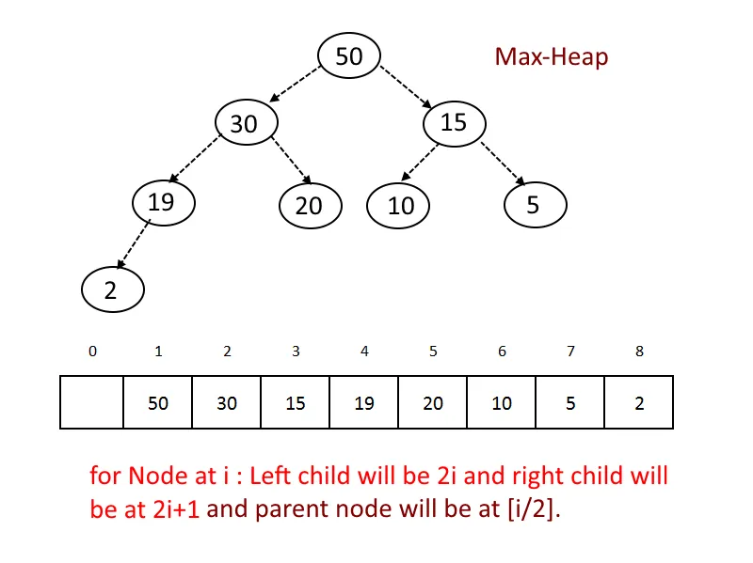
Heaps
A heap is a complete tree
Every level is full except possibly the last, and all nodes are as far left as possible.
Implemented with a list
min/max heap
In PA8, depends on which comparator you use

Slide 5
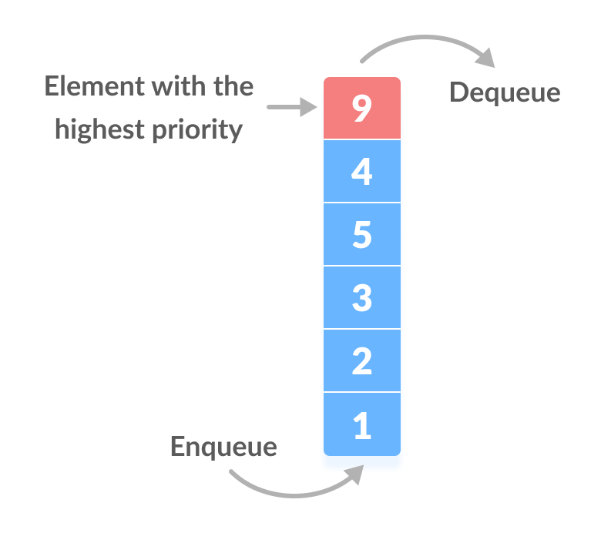
Priority Queues
Similar to a queue in the sense that we are adding/removing from the same location each time. However, now there is an order that is based on a priority value
Methods
poll()
add()
peek()
toArray()

Slide 6
Heaps vs Priority Queues
Heap is a Data Structure
Priority Queue is an Abstract Data Type (ADT)
Heaps are the most popular way to implement a Priority Queue because they efficient at finding the largest or smallest values (the priority). In fact, many times when people refer to a priority queue they are referring to a heap!
You will be creating a Heap class however you will use the Priority Queue interface provided.

Slide 7
What about the helper methods?

Slide 8
Bubble Down
Used for deleting an element from the heap
Take last element of heap and put it at the index of the element to be deleted
Check and Swap
Min-heap: if replaced element > any child node, swap element with the child that is smaller
Max-heap: if replaced element < any child node, swap element with the child that is greater
Keep repeating till conditions are not met

Slide 9
Bubble Up
Used for inserting an element into the heap
Insert element at the last leaf of the tree
Check and Swap
Min-heap: if inserted element < parent node, swap element with parent node
Max-heap: if inserted element > parent node, swap element with parent node
Keep repeating till the inserted element is in place
http://btv.melezinek.cz/binary-heap.html

Slide 10
Buffers

Slide 11
Buffer
Benefits: Improve performance and manage memory
Reads a csv file 10 lines at a time and stores the lines in the String[] buffer array
When we call getNext(), this gets the next line from buffer. If everything has been read in buffer, then we refill the buffer with the next 10 lines in the csv file.

Slide 12
Command-line Arguments

Slide 13
What are command-line arguments?
Command-line arguments allow the user to pass values to the program at runtime.
This is helpful if each time you need to run the program you need a different configuration. By using command-line arguments, you don’t have to change the variables each time you are about to run, you can just pass them!
Example:
On the command-line:
javac Hello.java
java Hello Rebecca
Hello Rebecca!

Slide 14
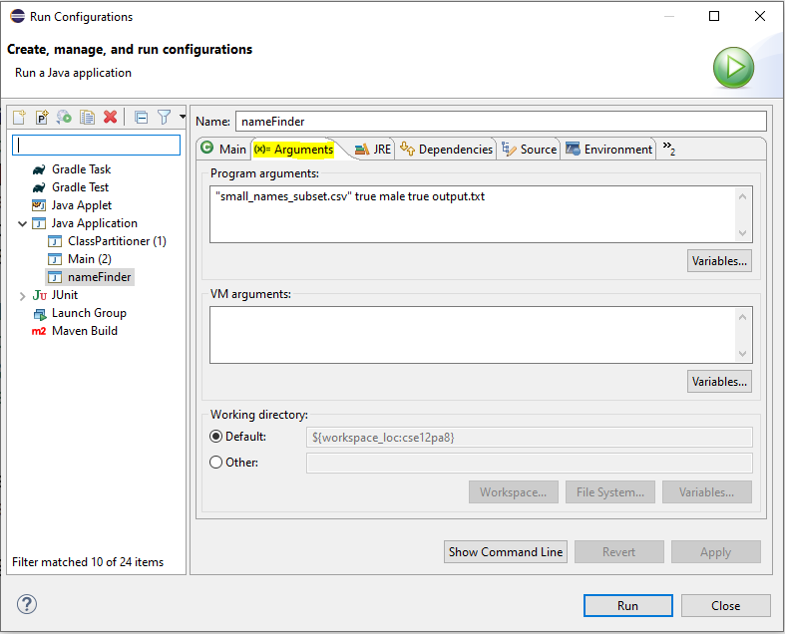
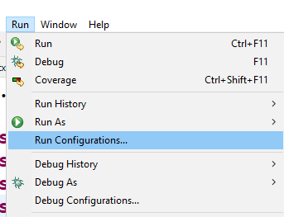
How do I pass arguments in Eclipse?

Slide 15
How do I use the passed arguments?
The arguments are passed in a String[] named args.
So if I pass the following: Harry true 67 apples
Then to access each I would do:
args[0] == Harry
args[1] == true
args[2] == 67
args[3] == apples
**Note**: They are all of type String!!!
If you want change the type you will need to do type casting.

